Slide 1
Coursera Capstone Project (Week 5) – Full Report
Indranil Chatterjee
November, 2018

Slide 2
Introduction/ Business Problem, Data Set
Target audience
The owner of the Chinese restaurant chain
Problem statement
To advise on current locations of Chinese (or similar) restaurants in Manhattan
Why
Based on current locations of existing restaurants, the chain can decide its location wise strategy
Data Set
New York location data from web (borough, neighborhoods, lat-long data)
Foursquare data for venue details

Slide 3
Brief Methodology, Analysis
NY Location Data
Borough, Neighborhood, Latitude, Longitude
Manhattan Data
Foursquare API
Venue Category Analysis
Chinese/ similar restaurants
Venue details
Counts per neighborhoods

Slide 4
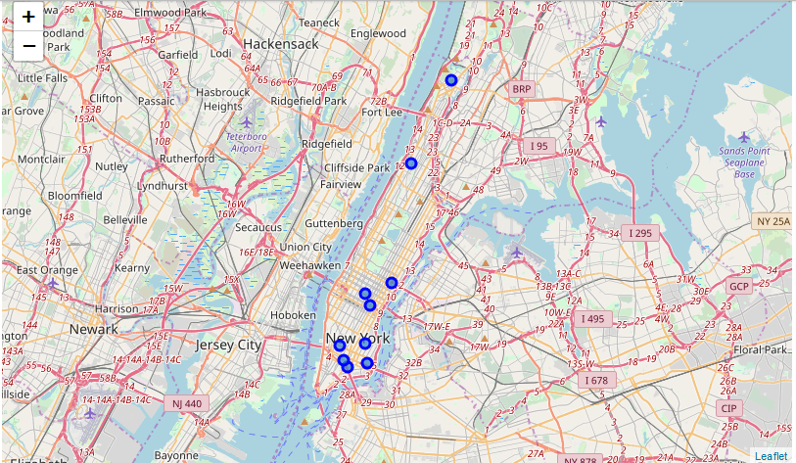
Results, Key Messages (1/2)
Neighborhood | Total
Chinatown | 17.0
Little Italy | 4.0
East Village | 4.0
Lower East Side | 3.0
Midtown | 3.0
Greenwich Village | 3.0
Sutton Place | 2.0
Inwood | 2.0
Murray Hill | 2.0
Hamilton Heights | 2.0
Top 10 neighborhoods with highest number of Chinese/ similar restaurants
Possible indication of existing client base – but more competition

Slide 5
Results, Key Messages (2/2)
Neighborhood | Total
Gramercy | 0
Chelsea | 0
Civic Center | 0
Upper East Side | 0
Turtle Bay | 0
Stuyvesant Town | 0
Marble Hill | 0
Soho | 0
Roosevelt Island | 0
Noho | 0
Hudson Yards | 0
Lenox Hill | 0
Midtown South | 0
Yorkville | 0
Neighborhood | Total
Tudor City | 1
Upper West Side | 1
Morningside Heights | 1
Battery Park City | 1
Carnegie Hill | 1
Lincoln Square | 1
East Harlem | 1
Financial District | 1
Flatiron | 1
Neighborhoods with only 0 or 1 Chinese/ similar restaurants
Possible indication of less competition, but market potential to be evaluated

Slide 6
Discussion/ Conclusion
Depending on the business strategy, the organization can focus either in areas where there are quite a few such restaurants (like Chinatown, Little Italy etc.) OR in neighborhoods where there are only 0 or 1 such restaurant
Limitation of the current analyis
Any sizing of the potential customer base is not covered, can be considered as a next step

Slide 7
Thank You!

